Slide 1

Promotional Gender Discrimination
Neinava Vardeh
Kahveh Kheymehdooz
Liona Memary
Zulma Serrano

Slide 2
Promotional Gender Discrimination
Civil Rights Act of 1964, Title VII
“Prohibits all forms of sex discrimination in employment including hiring, firing, PROMOTION, training and benefits”

Slide 3


The Applicants
John Smith
Jane Doe

Slide 4
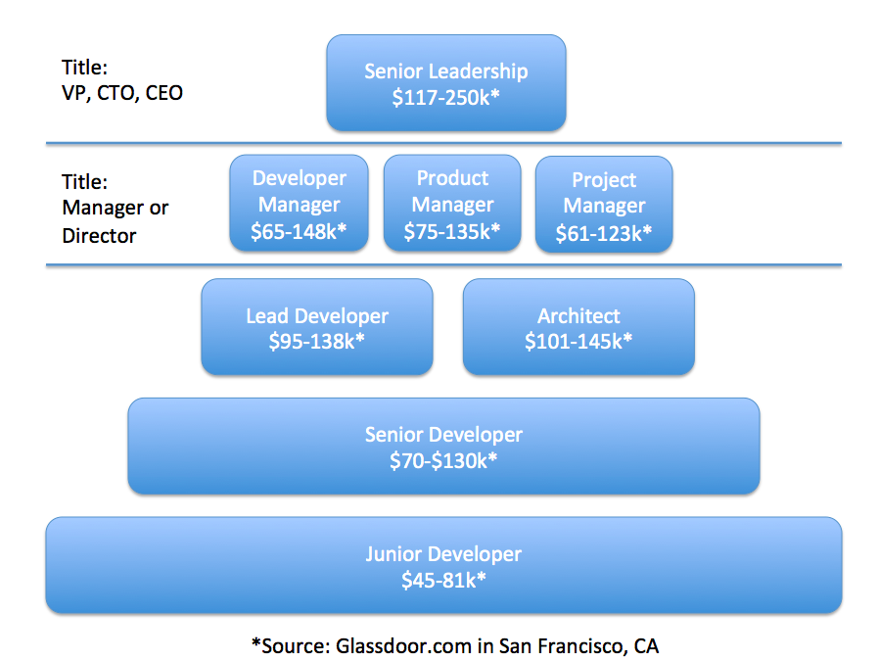
The Job Promotion
VP of Software Development
Qualifications:
8+ years of experience in Software Development
Graduate Degree in Engineering or Computer Science
Previous leadership role preferred

Slide 5
The Applicant’s Qualifications
John Smith
7 years of experience in Software Development
3 years with Company X
Bachelor’s Degree in Engineering
Current Position at Company X:
Lead Developer
Jane Doe
9 years of experience in Software Development
7 years with Company X
Master’s Degree in Engineering
Current Position at Company X:
Developer Manager

Slide 6
Vote!
Using your electronic device, visit this link:
http://etc.ch/JnMr
Vote for who you think deserves the promotion!

Slide 7
Voting Results!
Let’s check out the results and see who you think deserved the promotion!

Slide 8

The Lawsuit - Facts!
Huang is a software engineer
Filed a class action lawsuit against
Twitter in 2014
Huang and 50 other female employees
were denied promotions

Slide 9
Twitter’s Promotion Policy
A committee approves of applicants but doesn’t look at performance
The committee consists of mostly upper-management males
Acceptance or rejection is based on subjective measures

Slide 10

Some Statistics
30% of Twitter’s overall global workers
are female.
Only 10% of those females are in technical jobs.
  Only 4% are software engineers.
About 79% of Twitter’s Leadership team is male.

Slide 11
Back to the Lawsuit - Retaliation!
Twitter began a formal investigation on March 2014, with a one-week estimate.
Huang was put on personal leave during investigation.
Investigation took over 4 months.

Slide 12

The Lawsuit - Retaliation
Huang was never placed back from
personal leave.
The investigation ended up taking over
4 months.
No formal result of the investigation was
provided.

Slide 13
First Cause of Action
Sex Discrimination in Violation of FEHA
Disparate Treatment - Engaged in patterns and practices of intentional sex discrimination
Disparate Impact - Twitter’s subjective and gender-base system is not justified by a business necessity - or if it could be justified, less discriminatory alternatives exist.
Notes:
The California Fair Employment and Housing Act (FEHA) is the primary law that provides employees with protection from discrimination, retaliation and harassment in employment. All employment provisions of the FEHA anti-discrimination provisions apply to all employers with five or more full-time or part-time employees. In addition, the FEHA’s anti-harassment provisions apply to all employers with only one or more employees.
Many of the same nondiscrimination and harassment principles of federal law also apply under the FEHA. The FEHA provides protection from discrimination, retaliation and harassment in all terms and conditions of employment based on protected class .
Disparate Treatment. engaged in a pattern and practice of intentional sex discrimination in violation of FEHA connected with its treatment of Ms. Huang and the Class regarding their terms and conditions of employment.
Disparate Impact.. Twitter’s subjective and gender-based system is not justified by business necessity or, if it could be justified, less discriminatory alternatives exist.

Slide 14
Second Cause of Action
Retaliation in Violation of FEHA
Subjected to an adverse employment action
  Placed on administrative leave
  Projects reassigned to other employees
  Lost employment benefits

Slide 15

Third Cause of Action
Wrongful Termination in Violation of Public Policy
Under California Law, it is illegal for an employer to retaliate against an employee for reporting illegal activities, including sex discrimination
Notes:
Jurisdiction is invoked in this court pursuant to the public policy and common law of the State of California, pursuant to the case of Tameny v. Atlantic Richfield Company . Under California law, there is a fundamental and well-established public policy against retaliation for reporting illegal activities, including, but not limited to, complaining about sex discrimination. This public policy is embodied in the Constitution of the State of California and California statutes, Adverse employment actions taken by an employer in response to opposing discrimination or reporting illegal activity is contrary to this public policy and is thus actionable under the common law of California.

Slide 16
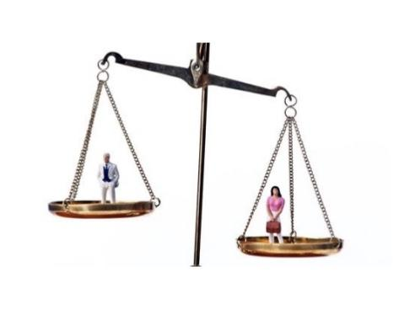
Tying It All Together...
Male candidate chosen over female candidate
Shows the discrimination Huang experienced while at Twitter
She was denied the promotion with no explanation

Slide 17

Violations...
Twitter violated three separate laws:
Title VII of the Civil Rights Act
FEHA - California state legislation
Public Policy

Slide 18
Going Forward...
Possible Solutions:
Have a diverse committee to approve/reject promotion cases
Promote people based on objective measures and performances
Keep candidates informed throughout the promotion process

Slide 19


Slide 20
Sources
http://www.businessinsider.com/ex-twitter-employee-tina-huang-sues-over-gender-discrimination-in-promotions-2015-3
http://www.sfgate.com/file/101/6/1016-HuangComplaint.pdf
https://www.bloomberg.com/news/articles/2016-02-10/at-twitter-a-gender-bias-claim-gets-swept-up-in-the-talent-wars
https://www.dfeh.ca.gov/legal-records-and-reports/laws-and-regulations/
http://dfeh.blogs.ca.gov/files/2016/09/CAamendedFEHAregsEmployers20160401Final.pdf

